Slide 1


Prepared for Understanding the UK EV Market
Prepared by: Narayanan Sowrirajan
Date of Presentation: 4th September 2023
Security Classification: Stakeholder Confidential

Slide 2
Plan for the Meeting
Summary of Proposal
Last Governance Board meeting requirements
RAID Log
Recommended Solution Stack
Documentation
Security Changes
Demonstration
Java Code
Fluent D
Matano
Sagemaker models
Superset Visualisation
Amazon Web Service

Slide 3
Summary of Proposal
Background
“Using data featured in the last few years regarding petrol, diesel and electricity. Predict how much these 3 fuels will be used in later years, and using this, determine if the UK will be able to handle a potential influx of electric cars.”
Data Source Used in Development
https://www.gov.uk/government/statistics/uk-road-transport-energy-consumption-at-regional-and-local-authority-level-2005-to-2021
(16 different Excel files within)
https://www.zap-map.com/ev-stats/ev-market
Data needed to create the electric car usage and BEV (battery electric vehicles)
Last Governance Board Meeting
Recommended Solution Stack
Secuity Implementation
Documentation

Slide 4
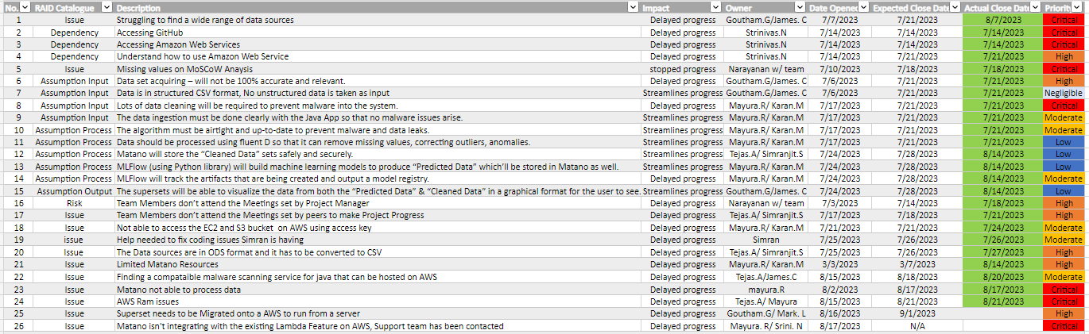
RAID Log (Active Document)

Slide 5
Our Recommended Solution Stack
Business Components | Key Tasks and Priorities | Tenacium DC + AWS Stack | Team Members
Data Sources | Speak with the relevant team members and acquire the necessary and relevant sources. | Srinivasan Raghavendran | Narayanan, James and Goutham
Page set-up | Set up a GitHub page to manage the open-source code Set up an AWS page as a base for the whole project to take place | Srinivas Nakka | Team
Secuity ​ | threat intelligence framework and deployment | James Chelliah | James
Support logging and auditing ​ | Monitoring the software and documenting the process, logging it onto the wiki. Adding the slides to the previous governace Board meetings in the ppt | Mayura and Tejas Simranjit | Tejas and Mayura
Data Ingestion | Understand the Java language and implement the required coding for data cleaning and to prevent malware getting into the system | Amazon EC2 | Tejas
Data Preprocessing | Using FluentD, the data to be processed and to identify the missing data as well as correcting any outliers using Ruby coding. | Amazon EC2 | Mayura and Karan
Data Storage | Understand the Java language and implement the required coding for data cleaning and to prevent malware getting into the system | Amazon EC2 | Mayura
Machine Learning | MLFlow (using Python library) will build machine learning models to produce “Predicted Data” which will be stored in Matano and to track the artifacts that are being created and output the model registry | Python Darts | Mayura and Karan
Data Visualization | The supersets will be able to visualize the data from both the “Predicted Data” & “Cleaned Data” in a graphical format for the user to see. | Superset | Tejas and Goutham

Slide 6
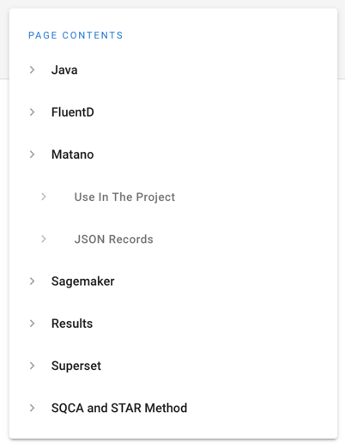
Documentation

Slide 7
Security implementation
Throughout this project we will be handling sensitive data it is critical that we conduct a security posture assessment to understand our position within the threat landscape and ensure our clients data is stored securely under the correct guidelines and policies. We will be using the BSIMM (Building Security In Maturity Model) framework to achieve this
What is BSIMM?
BSIMM is a framework module used by security analysts to analyze current security procedures and approach to examine where our security stands in comparisons to other firms identifying high water marks and their cost effectiveness throughout this process and then contrasting it where applicable with the BSIMM10 checklist to optimize procedures in accordance with threat landscape considering both current and emerging threats as well as security culture strategy.

Slide 8
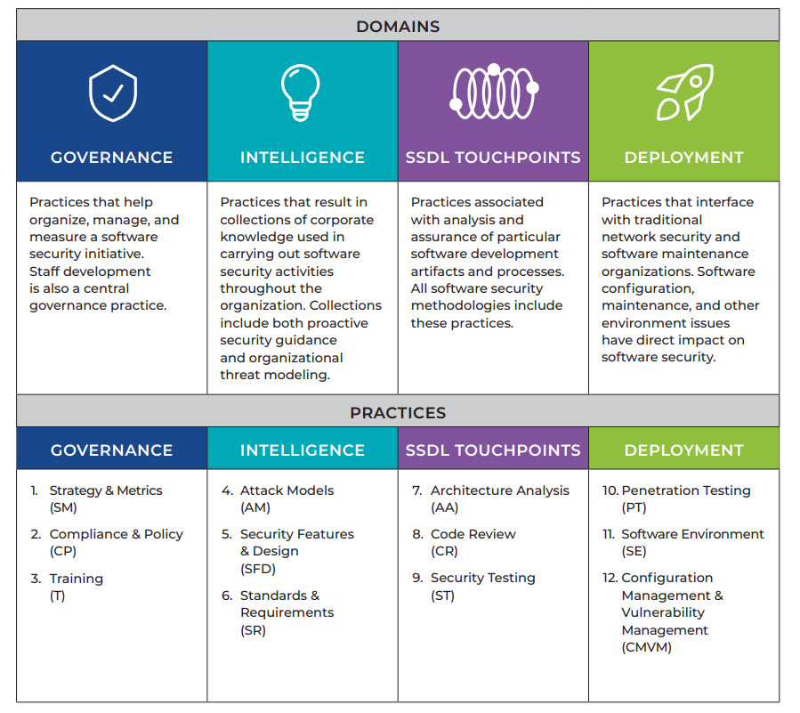
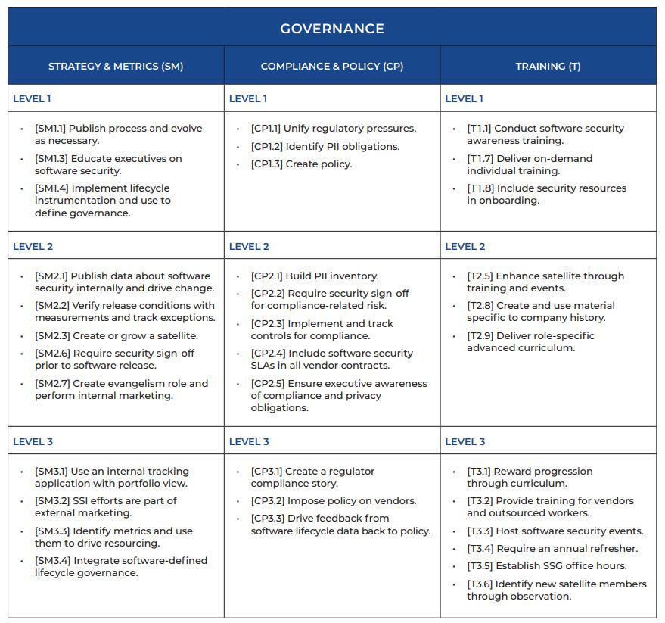
BSIMM
BSIMM framework categorizes procedures into 4 domains 12 practices 109 activities I will be assessing these and assigning 3 key activities for each practice for each domain which are most applicable for our project and provide the best ROI on our security

Slide 9
High level summary
Governance | Threat intelligence | SSDL touchpoints | Deployment
Security awareness Training (with template) Slide 10 | Our chosen TIP (CSFEPP) and why Slide 11 | Access controls Slide 12 | Incident report plan (with template) Slide 17-18
Required security sign off (compliance risk) Slide 10 | Our chosen Framework(CybOX™) and why Slide 11 | Risk assessment (with template) Slide 12 | Our chosen penetration method (OWASP) and why Slide 19
Outline security policies for referral to ensure compliance Slide 10 | Collation and contextualization of threat feeds Slide 11 | Code Review Slide 13-16 | Testing Slide 20

Slide 10
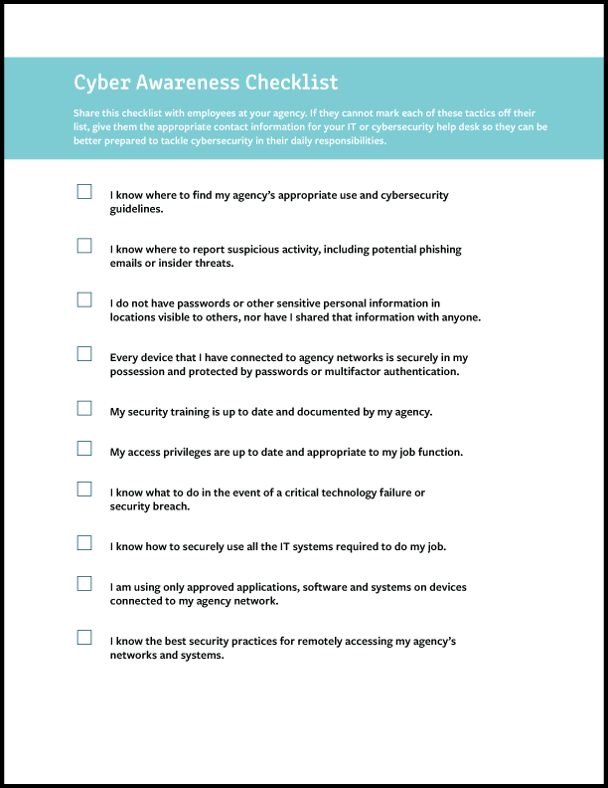
Governance
I have conducted a security awareness training with my team and have implemented a checklist for periodic checks to ensure employees are better prepared to tackle cybersecurity in their daily responsibilities
I have implemented required security sign of for compliance-risk
I have outlined company security policies to ensure they are always met and improved upon in accordance with the threat landscape

Slide 11
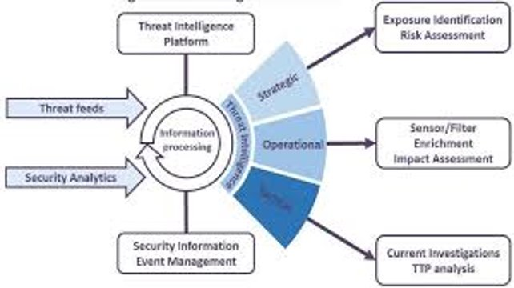
Threat intelligence
our chosen TIP to manage our position in the external security environment will be CrowdStrike Falcon Endpoint Protection Platform to provide near real time tactical threat intelligence and inform operational concerns for handling such threats and support strategic prioritization of cyber security issues.
Our chosen framework will be Cyber Observables (CybOX™) is a standardized schema for the specification, capture, characterization, and communication of threat related events. It provides a standard format for addressing cyber observables improving consistency, efficiency, interoperability, and overall situational awareness

Slide 12
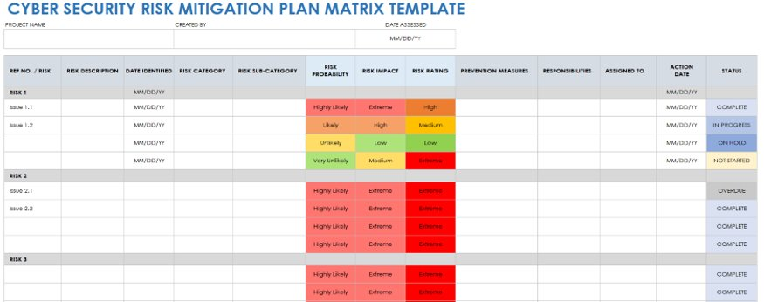
SSDL touchpoints
Access controls
To mitigate risk, we have implemented access controls to ensure only the correct people have access to data that they need which will aid in incident response.
Risk assessment
A cyber security risk assessment is the process of identifying, analyzing and evaluating risk. It helps to ensure that the network defense tools you choose are appropriate to the risks your organization faces. Without a risk assessment to inform your cyber security choices, you could waste time, effort and resources.

Slide 13
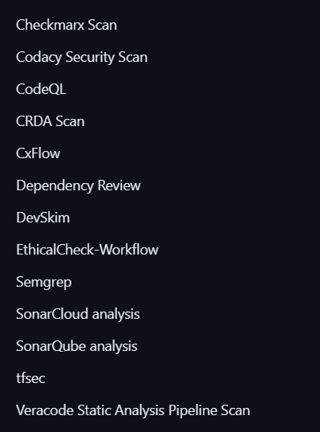
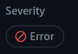
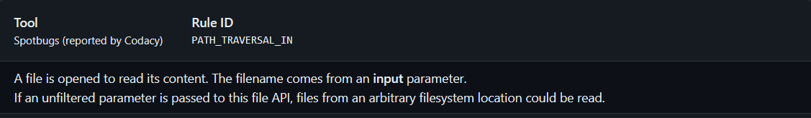
Code Review
To ensure our code was secure we employed the most applicable code security checkers
Upon integration we encountered an error
the error states how file Paths shouldn’t be hard-coded into the program

Slide 14
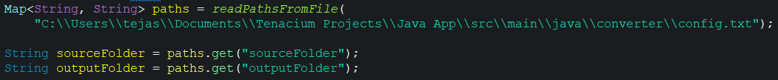
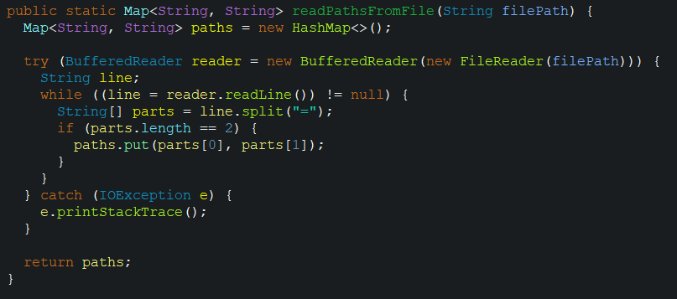
Code review
we resolved this by Uploading the File Paths to a text file and have the program read the Paths from it as you can see in these images below

Slide 15
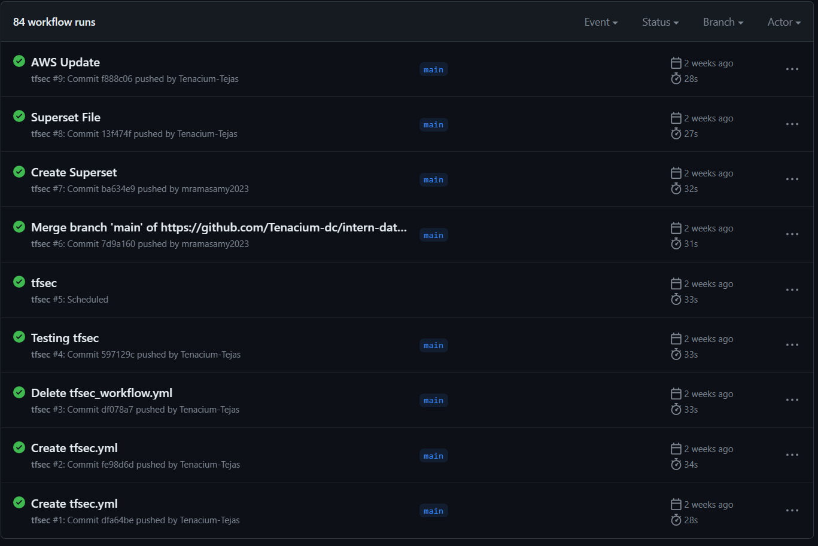
Code review
Upon correction we tested again and found no security errors ensuring this code is secure

Slide 16
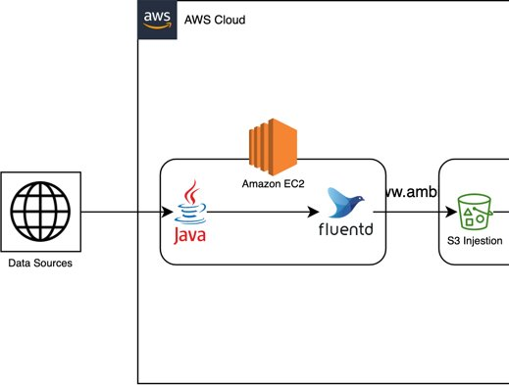
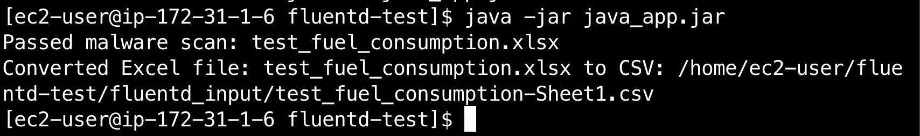
Code review
To further secure the project we have implemented ClamAV which is a malware scanner to ensure data integrity throughout the high-level approach a demo will be provided.

Slide 17
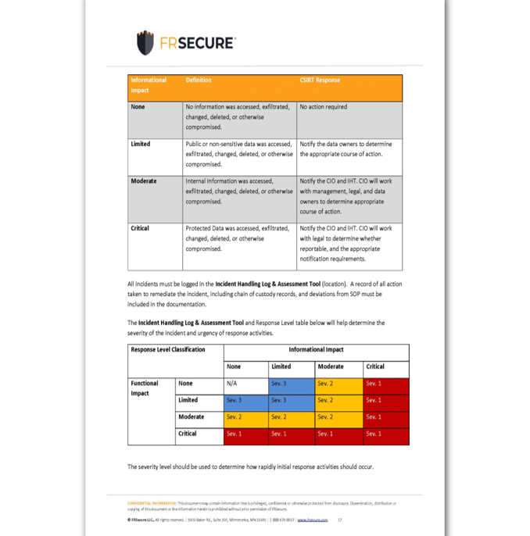
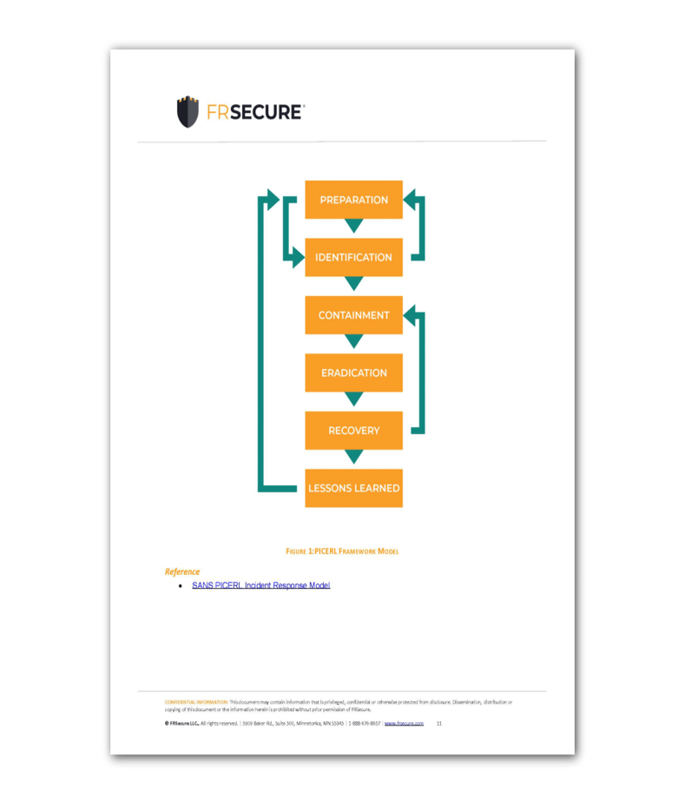
Deployment
Incident response plan
Incident response planning contains specific directions for specific attack scenarios, avoiding further damages, reducing recovery time and mitigating risk. Incident response procedures focus on planning for security breaches and how to recover from them these will be documented for educational purposes

Slide 18
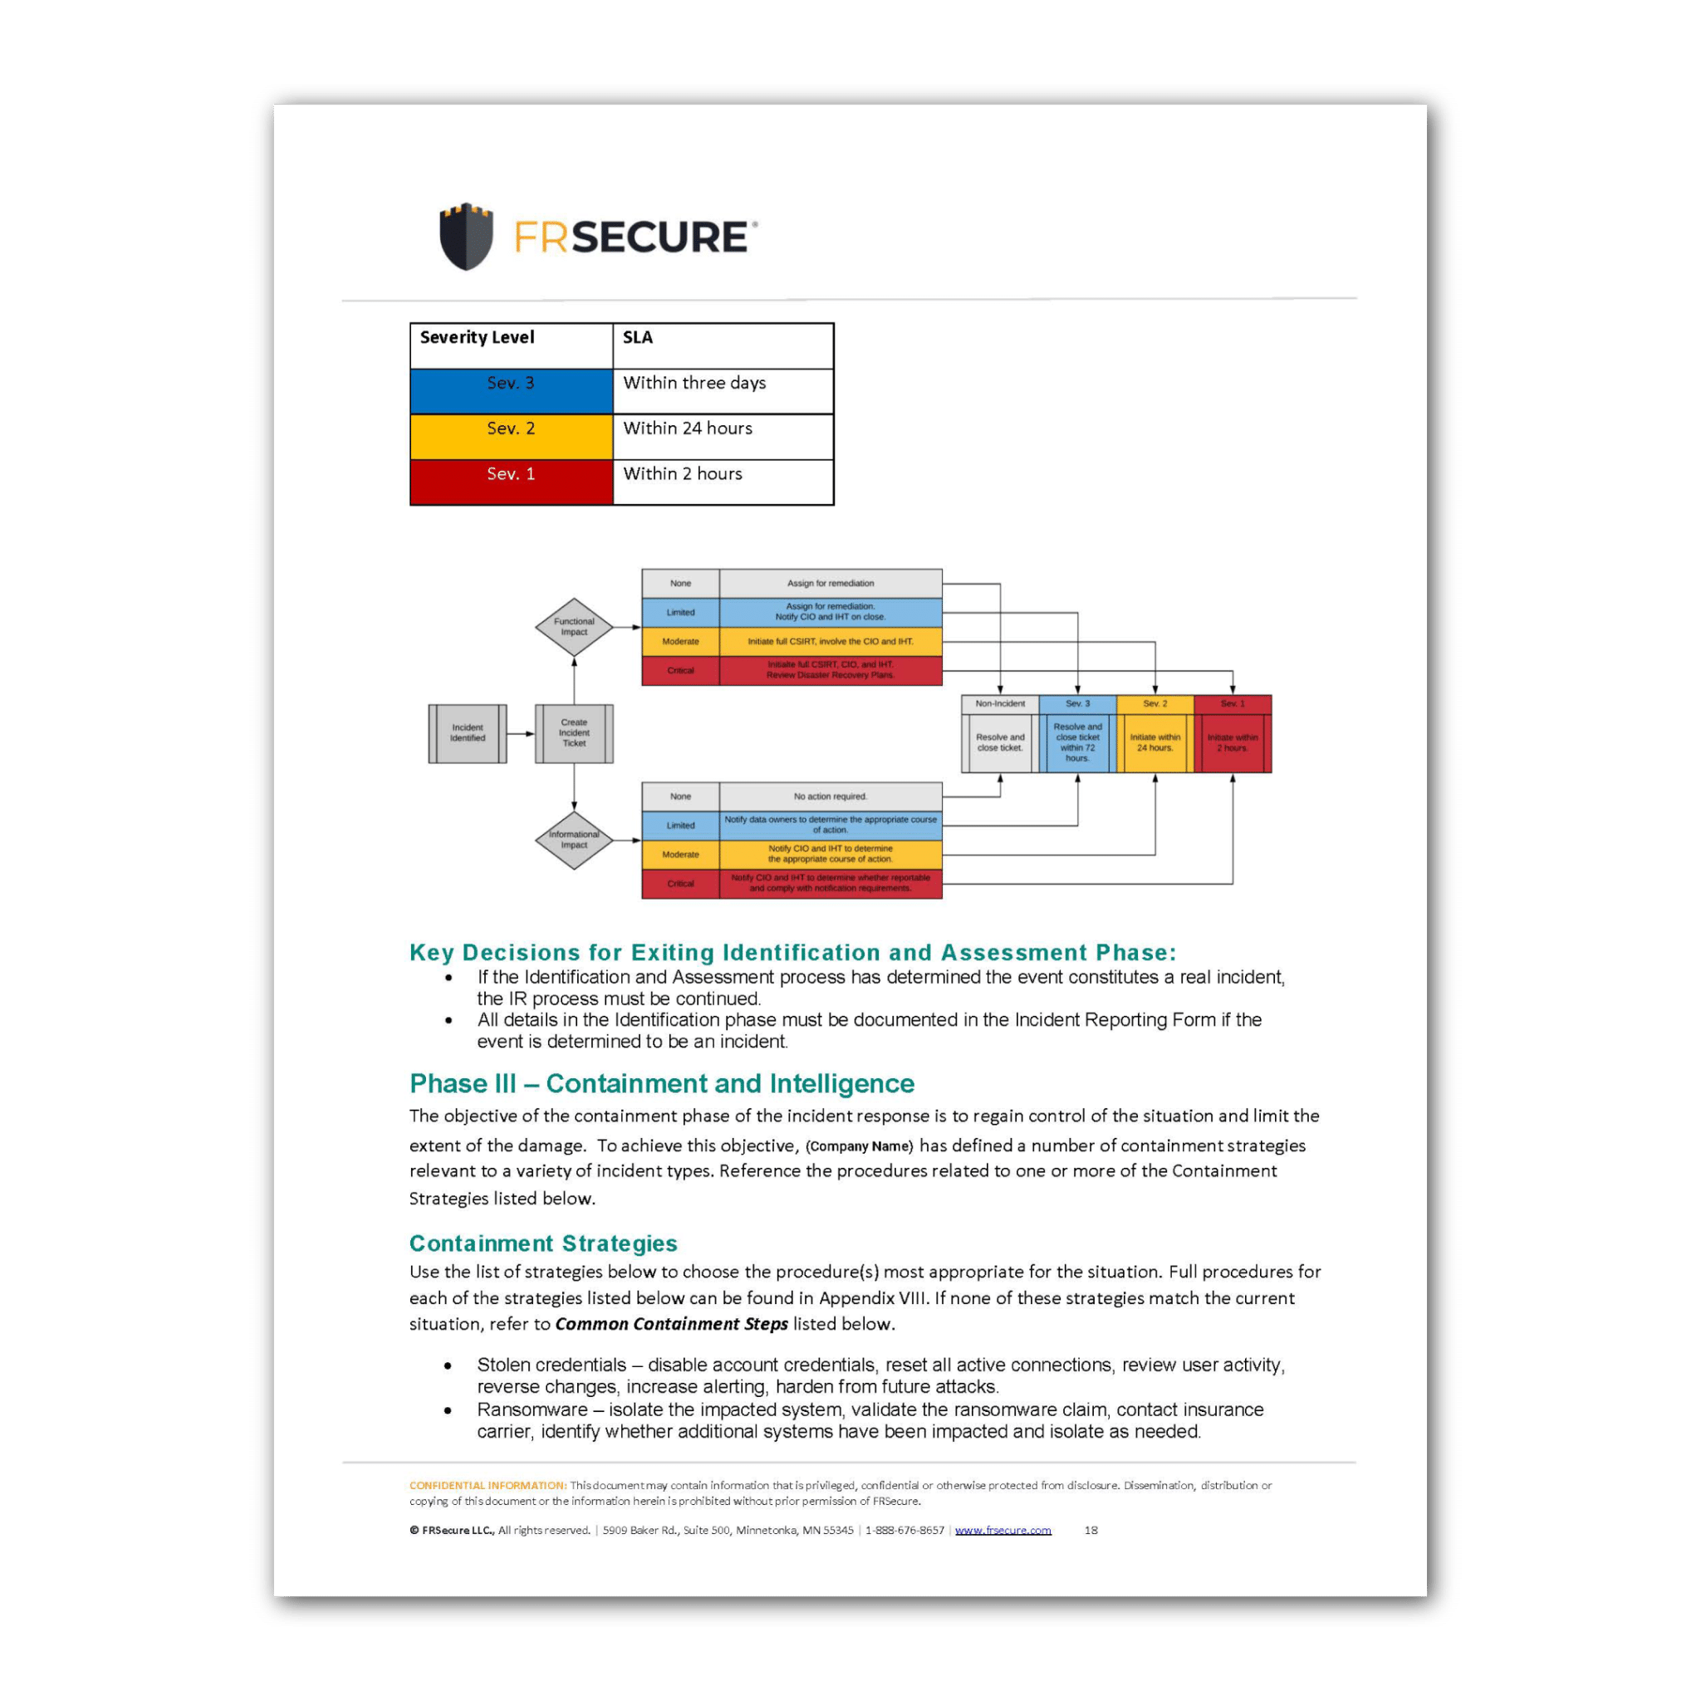
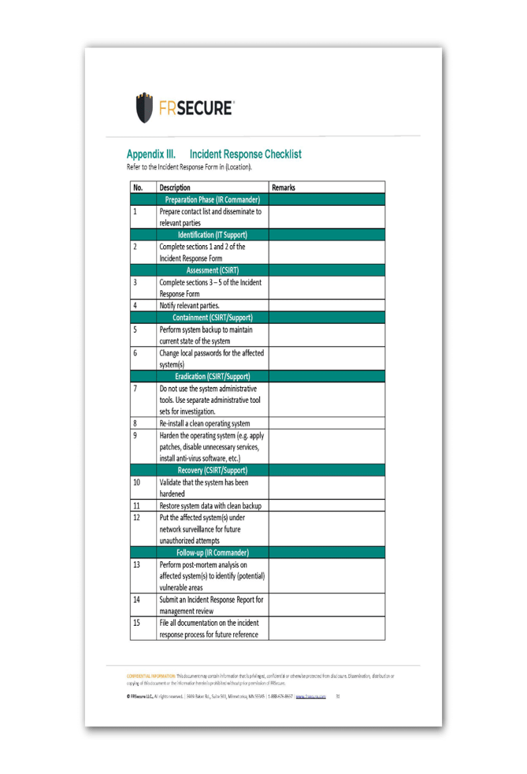

Slide 19
Deployment
Penetration testing
For this project we will be implementing OWASP tests OWASP is Recognised by developers and security professionals around the world, the OWASP Top Ten outlines key vulnerabilities that affect web application security. It was created by the Open Web Application Security Project (OWASP), a not-for-profit foundation that supports organisations to improve the security of their web applications.
the OWASP Top 10 is updated every three years. It provides a hierarchy of the most common web application security issues to help organisations to identify and address them according to prevalence, impact, method of exploitation by attackers, and ease or difficulty of detection.
OWASP pen testing covers the assessment of web applications to identify vulnerabilities outlined in the OWASP Top Ten. An OWASP pen test is designed to identify, safely exploit and help address these vulnerabilities so that any weaknesses discovered can be quickly addressed.
The OWASP Testing Guide (OTG) is divided into three key sections: the OWASP testing framework for web application development, the web application testing methodology, and reporting. The web application methodology can be used on its own or with the testing framework, while the framework can be used to build a web application focused on security, followed by a pen test (web application methodology) to test the design.
A key difference between OWASP and other penetration testing methodologies is that the OTG is solely focused on web application security throughout the whole software development lifecycle, unlike the ISSAF and the OSSTMM for example, which are aimed at security testing and implementation. Another difference is that the OWASP addresses controls while the OSSTMM does not.

Slide 20
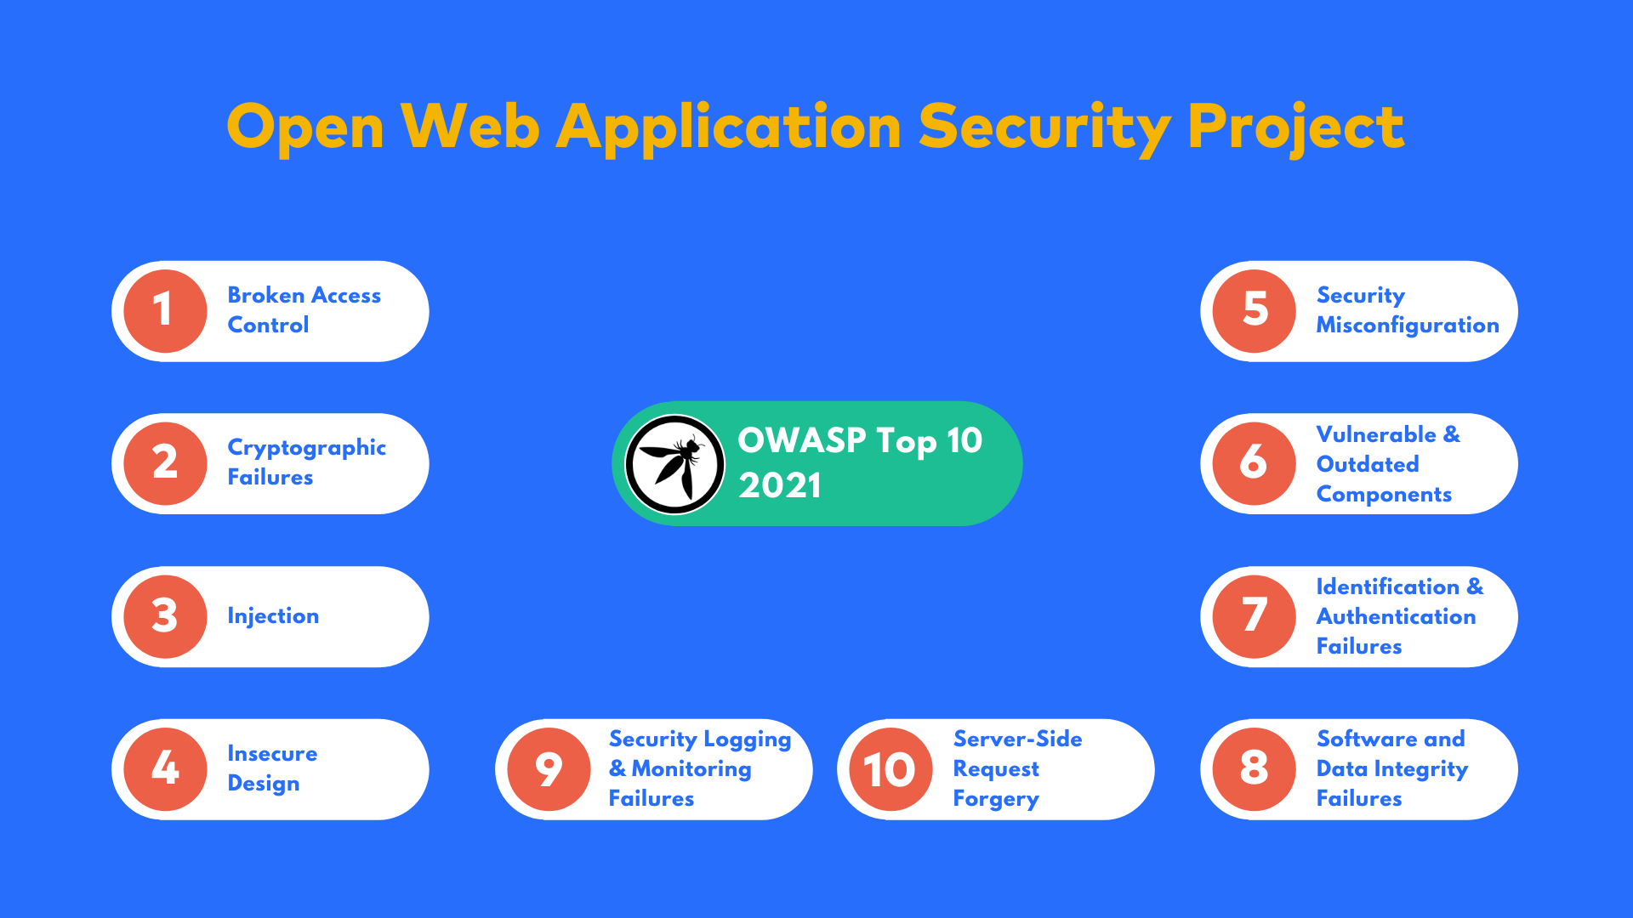
Testing

Slide 21
Demonstration

Slide 22
Demonstration Plan
Java Code
Fluent D
Matano
Sagemaker models
Superset Visualisation
Amazon Web Service

Slide 23


Thank you to the TenaciumDC Team, Swetha for conducting the scrum calls, Mark and Srini. N for helping closely throughout the project. I would also like to thank Balaji and Srini. R who helped with the governance of the project.

Slide 24
Thank you for Listening, any final Questions or Recommendations?

